Slide 1
2.2 A : Continuing Development on the Skunk Game

Slide 2
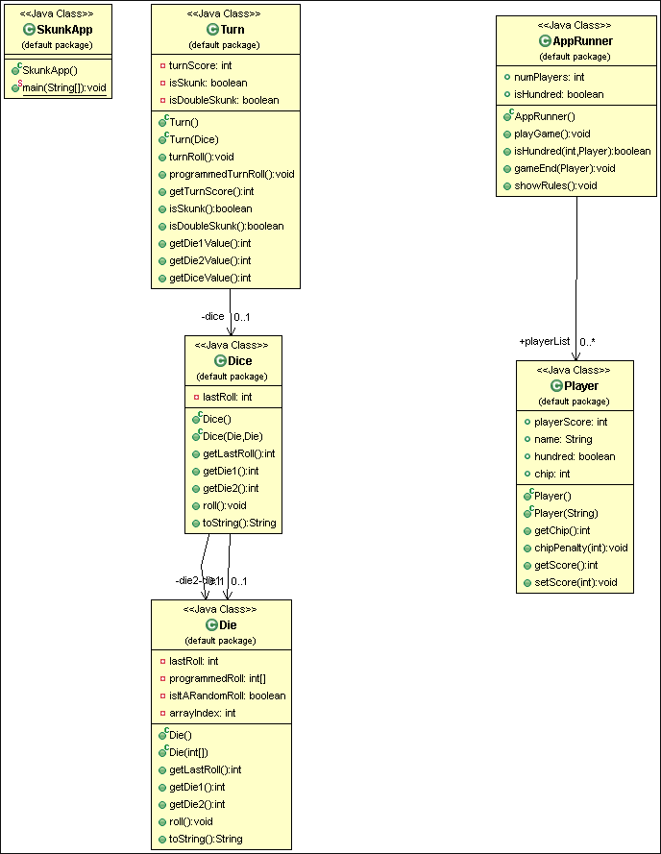
TP_1.3 UML

Slide 3
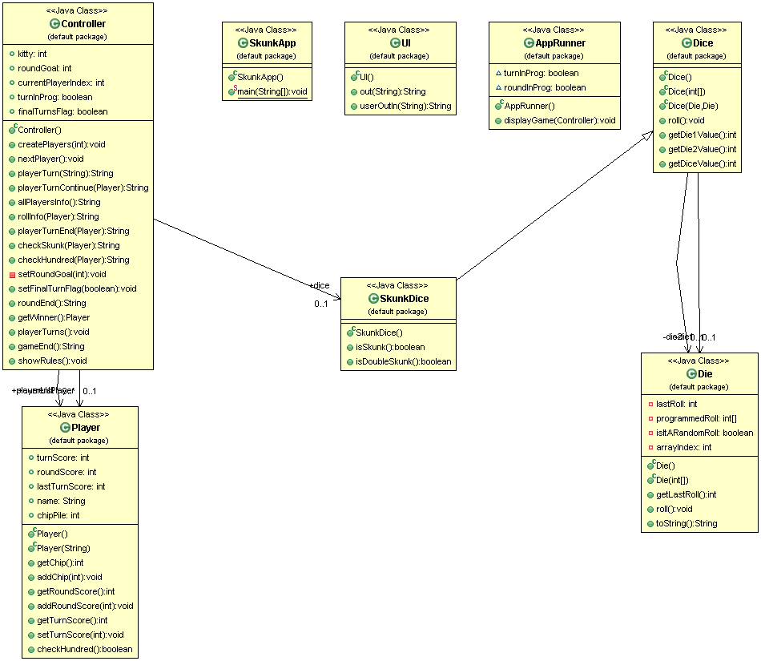
TP_2 UML

Slide 4
Continuing Development
Continued game development to extend from a single round to an entire game
Applying good naming practices
Working on separating business logic with UI
Decoupling classes
Unit Testing

Slide 5
Name Refactoring
commit ddcd353b45ca854bdbd7171ce37215b97994d12b
getDie1()
Method sounds like it is returning a Die object
getDie1Value()
Renamed so it’s now apparent a value is being returned
getScore()
Not descriptive; in this game there are different scores going on
getRoundScore()
Descriptive of the specific score that’s being retrieved
addSubChip(int chip)
Method can add or subtract chips, but looks a little confusing (am I adding a sub chip? What is a sub chip?)
addChip (int chip)
Because negative integers can be used, addChip() seems acceptable

Slide 6
Decoupling
commit 405a7751764ffa4ef19d5ad3e195f6d2d675e2fb
Player and Dice class were originally coupled:
Example: dice.roll(Player player) rolled dice and updated a score field in Player object, AND had game logic within
Followed GRASP and uncoupled them:
Took away Dice object parameters
Created new class that extends Dice - SkunkDice
Moved the game logic from Dice to SkunkDice

Slide 7
Redundant Classes and Methods
commit b6a97f535ebb2e6e614fc2d57db788016c720db3
While refactoring, was able to completely remove a redundant object - Turn
Realized having Turn as a separate object wasn’t needed
Was able to take its methods and either completely remove them, or move them to another class without significant changes in game functionality
Methods dealt with Player and Dice objects; was acting almost like a mini-controller for these two classes, and keeping track of Turn score
Turn score now kept in Player object, and re-initialized after every turn

Slide 8
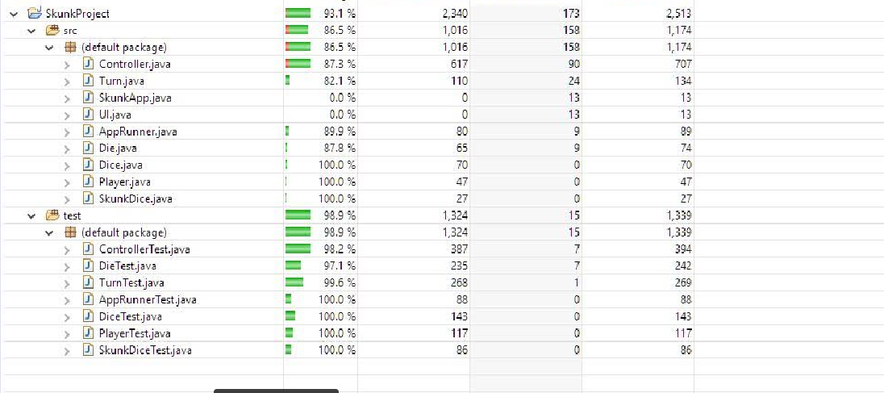
Code Coverage

Slide 9
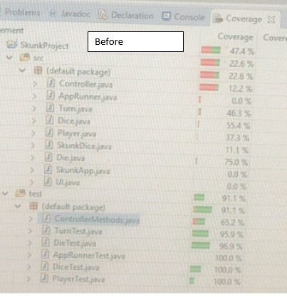

Slide 10
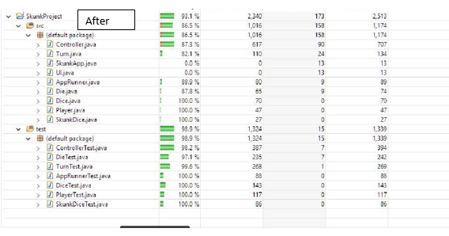

Slide 11
What could have been done better?
Better source control
Found commit history being wiped out
Pushes directly into Master - need to lock that down
Old classes reappearing in codebase - sitting on old version in local environment too long?
Use of .gitignore to keep environments clean
Test Driven Development
Prevents needing to run through wole program after every change
Found difficult to write
UI-Logic Separation
Difficult to pull apart after accidently writing them together
Better Planning
Using diagrams
Following GRASP methods from the beginning
Making sure everyone was using version control the same way

